Slide 1

INES DIGITAL LIBRARY
Transformer-Based Voice-Interactive System for Book Retrieval and Audio-Reading
System focus
A role-based digital library connected to MySQL, PHP APIs, React/Vite, and Python AI speech services.
Presenter: Anne Louange
Institution: INES-Ruhengeri
Notes:
Open with the project name and explain that the system is a practical digital library plus voice features.

Slide 2

INES DIGITAL LIBRARY
Problem Statement
Notes:
Problem statement comes before objectives, as in the dissertation. Use the image to explain the main challenges with few extra words.

Slide 3
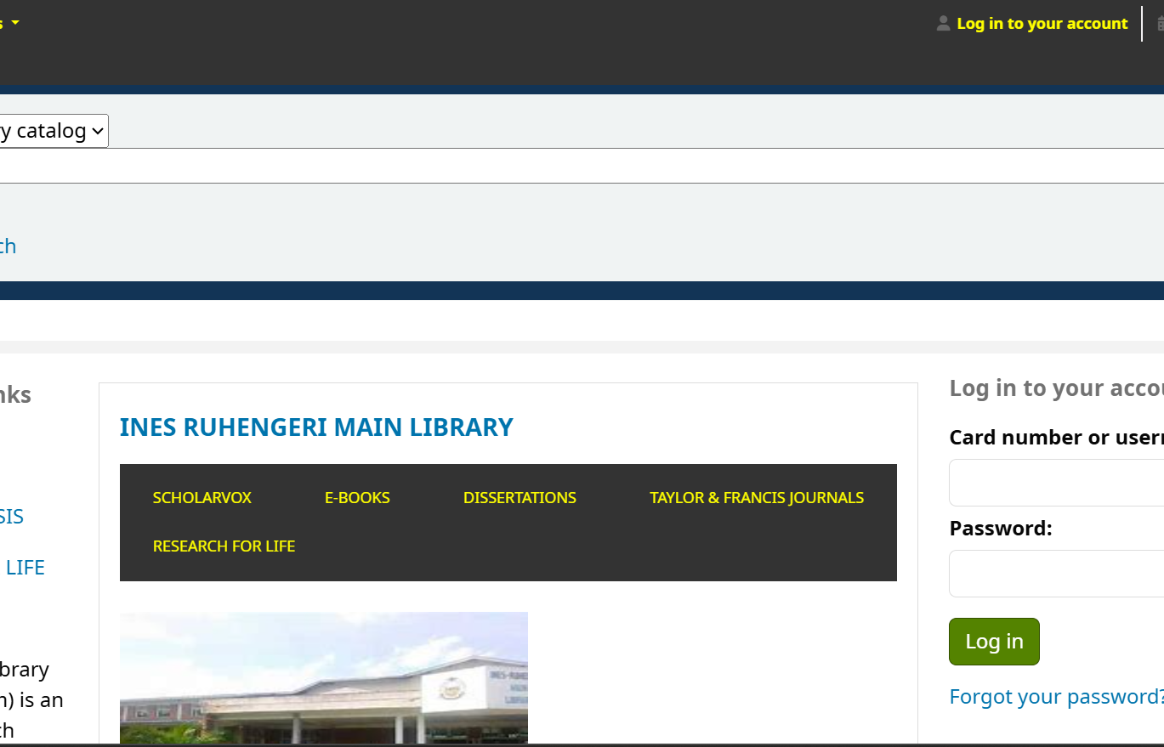
INES DIGITAL LIBRARY
Current System
Main challenges
Typed catalogue search only
No voice search
No audio-reading support
Limited support for reading difficulties
Less convenient access to resources
Need: easier book retrieval and more inclusive reading support.
Notes:
Use the screenshot to explain the current/manual web catalogue experience and its limitations.

Slide 4
INES DIGITAL LIBRARY
Research Objectives
General objective
To design and develop a Transformer-Based Voice-Interactive System for Book Retrieval and Audio-Reading that enhances accessibility and inclusive learning within INES Ruhengeri Library.
Specific objectives
Collect and analyze accessibility and digital-library requirements.
Design and implement Transformer-based STT and TTS support.
Develop authentication and role-based access control.
Evaluate performance, usability, and resource accessibility.
Notes:
These objectives match the final dissertation book wording in concise slide form.

Slide 5
INES DIGITAL LIBRARY
New System
Frontend
Backend
Database
React + Vite user interface
PHP API controls business logic
MySQL stores users, books, records
AI services
Security
Demo safety
FastAPI + PyTorch speech services
Token authentication and role access
Health checks and model preload
Notes:
Explain that the frontend never connects directly to MySQL or Python. It goes through the backend.

Slide 6
INES DIGITAL LIBRARY
Proposed voice-interactive system
Notes:
Use this short break to transition from objectives to the implemented solution.

Slide 7
INES DIGITAL LIBRARY
Methodology
Project stages
1
2
3
4
5
Study problem
Collect needs
Design system
Build system
Test system
Data collection
Testing
Used to understand library needs, user challenges, and required system features.
Used to check login, search, book reading, database, speech-to-text, and text-to-speech.
Notes:
Keep this simple during presentation: problem, needs, design, build, and test.

Slide 8
INES DIGITAL LIBRARY
Authentication and User Access
Login is submitted from React through frontend/src/api/auth.js.
The PHP backend verifies the password using password_verify().
Key point
A random token is generated, hashed, and stored in users.api_token_hash.
The database stores the hashed token, not the raw session token.
React stores the raw token as ines_token and sends it as a Bearer token.
ProtectedRoute and PHP role middleware restrict student, lecturer, and admin pages.
Notes:
Mention the important files: AuthContext, api/client.js, api.php, auth.php, role.php.

Slide 9
INES DIGITAL LIBRARY
Speech Connection
Frontend
PHP backend
FastAPI
PyTorch model
Frontend
Microphone or play button
Validates request and calls speech service
Receives audio/text
Runs Wav2Vec2, SpeechT5, or gTTS fallback
Shows text or plays audio
Why it can delay: first model load, CPU speed, long page text, audio conversion, network for gTTS, or Python service not already warm.
Notes:
This slide answers where STT/TTS connects to backend and frontend.

Slide 10
INES DIGITAL LIBRARY
Python Libraries and PyTorch
PyTorch
Runs transformer neural networks for STT/TTS inference and testing.
Transformers
Loads Wav2Vec2, SpeechT5, processors, and vocoder models.
FastAPI + Uvicorn
Expose Python speech models as HTTP services.
Librosa, NumPy, SoundFile
Prepare audio: load, resample, normalize, and save waveforms.
gTTS
Provides clearer Google text-to-speech fallback when internet is available.
Notes:
Use the prepared document for deeper dependency explanations.

Slide 11
INES DIGITAL LIBRARY
Technologies Used
Frontend
Backend
Database
React, Vite, CSS
PHP API, PDO
MySQL
AI services
Speech
Local server
Python, FastAPI, PyTorch, Transformers
Wav2Vec2, SpeechT5, gTTS
XAMPP
Notes:
Vite is the frontend build and dev server tool. PDO is PHP Data Objects, used for safe MySQL access.

Slide 12
INES DIGITAL LIBRARY
Live Demo Flow
1
Login
2
Frontend pages
3
Backend health
4
Database tables
5
Voice search
6
Play narration
Show frontend as the visible React/Vite pages, backend as the PHP health/API behavior, and database as MySQL tables in phpMyAdmin.
Notes:
Use this as the exact demonstration path. Show login, dashboards, reader, backend health, phpMyAdmin tables, voice search, and narration.

Slide 13
INES DIGITAL LIBRARY
Conclusion
The project implements a working digital library for academic resource access.
Authentication connects frontend users to backend permissions and database records.
STT and TTS are connected through backend-controlled Python AI services.
Testing must cover login, database, search, reader, STT, TTS, and health checks.
Notes:
Summarize achievements without overclaiming model training or survey validation.

Slide 14
INES DIGITAL LIBRARY
Recommendations
Deploy on a server that supports PHP, MySQL, and persistent Python FastAPI services.
Improve TTS quality with better text cleaning, chunking, and a stronger production voice.
Add full questionnaire/interview appendices if user validation is claimed.
Add mobile support and multilingual speech support in future work.
Notes:
Recommendations should sound practical and connected to known limitations.

Slide 15
THANK YOU
Defense reminder
Answer using real project files, real services, and tested behavior.
Questions and answers
Notes:
Thank the panel and invite questions.

